Slide 1

Importing and
Filtering Data
Notes:
In this video, we’ll learn how to import our data and better filter it as well.

Slide 2
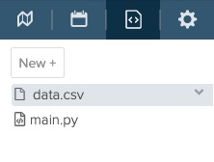
Importing Data
import pandas as pd
df = pd.read_csv (r"data.csv")
Notes:
You may have noticed the code shown in some of the past examples. Pandas has the ability to read and import many different types of data files. Here we see how to import a csv file. CSV stands for comma-separated values. A csv file is a simple text file in which information is separated by commas. Many data files that you may find online are formatted as csv files. If you’d like to import a different type of file, you can either convert the data file to a csv file or check out the Pandas documentation on how to do that!

Slide 3
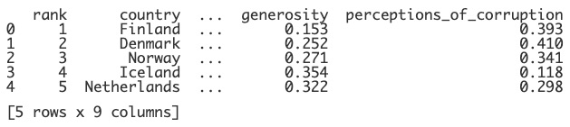
Importing Data
import pandas as pd
df = pd.read_csv (r"data.csv")
print(df)
Notes:
When we print out the data at first, it is shown as a condensed table. You’ll notice the ellipsis, or 3 dots, which lets us know that there is more information that isn’t being shown.

Slide 4
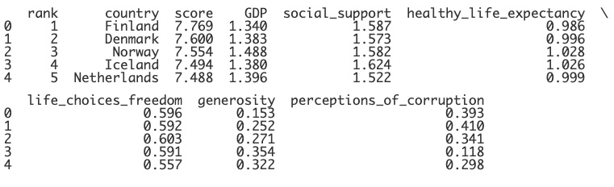
Importing Data
import pandas as pd
df = pd.read_csv (r"data.csv")
pd.set_option("display.max_columns", None)
print(df)
Notes:
If we’d like all of the columns to be shown, we can set the option for max_columns to None as shown here. Now, we can see all of the columns! They are separated into two lines because of the size of the viewing window. Remember that you’ll want to resize your editor until the table is readable. This symbol here means that this is the spot where the data is split into a new line.

Slide 5
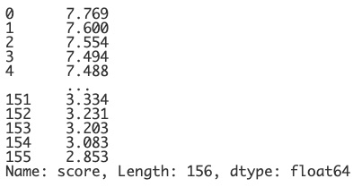
Dot Notation
print(df["score"])
print(df.score)
Notes:
Now, that our data is imported, let’s learn about a few “shortcuts.” One is dot notation. In the past, when we wanted to filter for a column, we would call on the dataframe and then put the column name in brackets and quotes. It’s a lot of syntax to remember! Dot notation shortens this process. You can also call on the dataframe and then type in a dot and the name of the column and this will result in the same thing! So, why haven’t we mentioned this before?? Well, it’s because this shortcut doesn’t ALWAYS work.

Slide 6
Dot Notation
print(df["country", "score"])
print(df.country.score)
print(df["health score"])
print(df.health_score)
Notes:
You will still need to use bracket notation if you’d like to filter for more than one column. There is no dot notation equivalent of this. In the same way, you’ll need to use bracket notation if the name of the column contains a space, or a common Python keyword. Dot notation won’t work here either.

Slide 7
Dot vs. Bracket
Dot notation is easier to read, write and remember.
Dot notation only works with single columns that do not include spaces, keywords, variables, etc.
Bracket notation always works.
Notes:
So, in summary, dot notation is great to use to keep your code neat and easier to read and write! However, it does not always work. You CAN rewrite the names of your columns to ensure that they do not include spaces or keywords. Either way it’s important to know that bracket notation will always work even if the dot notation shortcut doesn’t.

Slide 8
Review: Filtering Data
filtered_df = df["country", "score"])
print(filtered_df[3:7])
print(filtered_df[df["country"] == "Ghana"]))
Notes:
We are also going to learn a different way to filter our data. If we wanted to filter for both the columns and specific rows or conditions, we had to use multiple steps. We could create a filtered dataframe that only included the columns that we wanted and then use this dataframe and filter for the specific number of rows, or a specific condition. Again, it was a lot of steps and a lot of syntax.

Slide 9
Index-Based Selection - iloc
dataframe.iloc[rows, columns]
print(df.iloc[0:2, 3:7])
Index-based selection (iloc) selects rows and columns by their index location or address in the table.
iloc selects exclusively.
Selects rows from index location 0 to 1.
Selects columns from index location 3 to 6.
Notes:
There are two different ways that we can filter for both specific rows AND columns at the same time. The first is called index-based selection and is used with the keyword iloc. Iloc selects rows and columns by their index location in the dataframe. This works exclusively, which means the second number listed is not included. The code here will select row from the index location of 0 to 1 (not 2) and columns from index location 3 to 6. 7 will not be included.

Slide 10
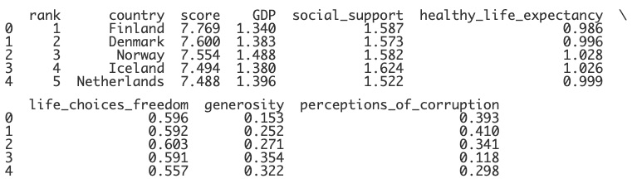
Index-Based Selection - iloc
Notes:
We are familiar with indices of rows, but how does it work with columns? It’s not displayed anyway, but columns are indexed in the same way.

Slide 11
Index-Based Selection - iloc
0
1
2
3
4
5
6
7
8
Notes:
The first column will have an index of 0 and then the numbering will continue.

Slide 12
Index-Based Selection - iloc
print(df.iloc[0:2, 3:7])
Notes:
So, if we go back to this code, it will print rows 0-1 and columns 3 to 6.

Slide 13
Index-Based Selection - iloc
print(df.iloc[0:2, 3:7])
3
4
5
6
Notes:
Here you can see the indices of the columns.

Slide 14
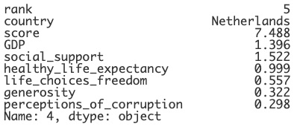
Index-Based Selection - iloc
print(df.iloc[4])
Notes:
Iloc can also be used to return just one item. The code shown here will print all the information for the row with the index 4. Notice that the index was 4 (since it started at 0) but the rank shown here is 5 because it starts at 1.

Slide 15
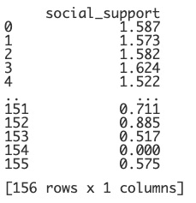
Index-Based Selection - iloc
print(df.iloc[:, 4:5])
Notes:
If we leave out numbers and just use a colon, everything will be returned. So, here we are returning ALL rows but filtering for JUST the column at index 4. Remember 5 won’t be included.

Slide 16

Index-Based Selection - iloc
print(df.iloc[:3, :2])
Notes:
Can you guess what this might return? Which rows? Which columns?
This returns rows with index location 0 to 2 and columns with index location 0 to 1.

Slide 17

Index-Based Selection - iloc
print(df.iloc[[2, 4, 6], [0, 5]])
Notes:
Iloc can also be used to return specific rows and columns. What do you think will be returned here? Here we see rows with index location 2, 4 and 6 and columns with index location 0 and 5.

Slide 18
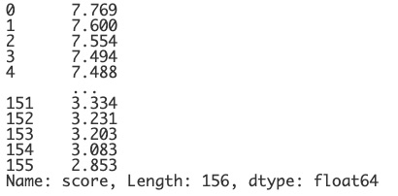
Label-Based Selection - loc
dataframe.loc[rows, columns]
print(df.loc[:,"score"])
Label-based selection (loc) selects rows and columns by their label or name in the table.
loc selects inclusively.
Notes:
It’s sometimes confusing to use the indices since the numbering starts at 0, so there is another method called label-based selection. This uses the keyword loc. Loc selects rows and columns by their LABELS instead of the index location. It also selects inclusively, so the last number WILL be included. It works the same way with rows first and then columns. Can you guess how the code shown might work. This will choose ALL rows and filter for the column labeled score.

Slide 19
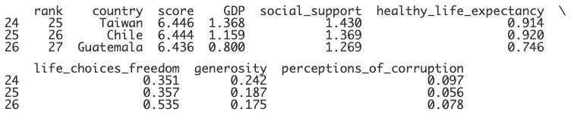
Label-Based Selection - loc
print(df.loc[24:26])
Notes:
Take a guess here. What will this return? This returns rows with the index 24 through 26. The 26 is included here!

Slide 20
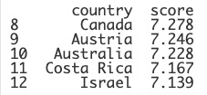
Label-Based Selection - loc
print(df.loc[8:12, ["country","score"]])
Notes:
Now, we can filter for rows and columns at the same time! What do you think will be displayed here? This will display rows with index 8 through index 12 and filter for only the country and score columns. Now, we have to be careful here. We aren’t selecting rows with index 8-12 because they are in that location but because they are labeled as 8 through 12. Let’s make this clearer.

Slide 21
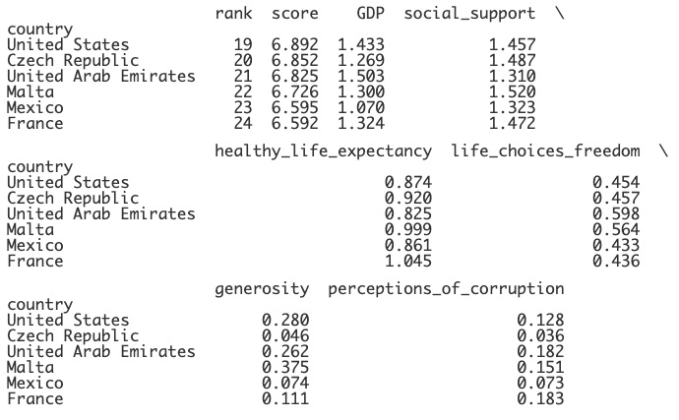
Label-Based Selection - loc
df.set_index("country", inplace=True)
print(df.loc["United States":"France"])
Notes:
If we changed the index to the country columns, we wouldn’t be able to use the numbers to select the rows anymore using loc. However, we COULD use the names or labels of the rows. This code will display rows from United States to France and ALL columns.

Slide 22
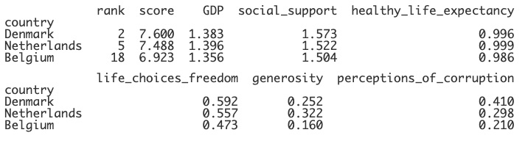
Label-Based Selection - loc
df.set_index("country", inplace=True)
print(df.loc[["Denmark","Netherlands","Belgium"]])
Notes:
You can also just choose specific rows to display. This can definitely come in handy and might be easier than trying to use the indices.

Slide 23
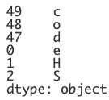
iloc vs. loc
s = pd.Series(["c", "o", "d", "e", "H", "S"],
index=[49, 48, 47, 0, 1, 2])
print(s)
Notes:
Alright, I’m going to challenge to you a few questions to see how well you understand the differences between iloc and loc. We’ll start with a simple Series - but I’ve changed the indices. Remember that iloc chooses by index LOCATION and loc chooses by index LABEL.

Slide 24
iloc vs. loc
print(s.loc[0])
Answer: e
The value at index label 0 is printed.
Notes:
Pause the video and try to determine what this will return. Use the Series shown.
This selects e because it’s at the index that is LABELED 0.

Slide 25
iloc vs. loc
print(s.iloc[0])
Answer: c
The value at index location 0 is printed.
Notes:
How about if we change it to iloc instead?
The answer here is C because the index LOCATION at 0 is always the first row in the table.

Slide 26
iloc vs. loc
print(s.loc[0:1])
Answer: 0 e
1 H
The rows at index labels between 0 and 1 (inclusive) are printed.
Notes:
Here’s another one. Pause the video and take a guess. This will return the two rows that are LABELED 0 and 1. 1 is included since loc is inclusive.

Slide 27
iloc vs. loc
print(s.iloc[0:1])
Answer: 49 c
The rows at index location between 0 and 1 (exclusive) are printed.
Notes:
What will be returned if we change it to iloc?
If you said 49 and c, you are correct! The index LOCATION at 0 in the first row and since it’s exclusively, the second row is not included.

Slide 28
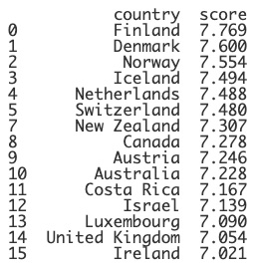
Boolean Selection
print(df.loc[rows, columns])
print(df.loc[rows, ["country","score"]])
print(df.loc[df.score > 7, ["country","score"]])
Notes:
So, do you have a favorite between loc and iloc? They are both useful is different situations. Another advantage of loc though is that it can also be used together with Boolean selection or using conditions. Let’s fill in the columns here - we only want country and score to be displayed. We can type in a conditional in the row section and now it will filter for only the rows where the score is greater than 7! There are so many good uses for loc and iloc and we’ll see more in the next live code video.

Slide 29
Lesson Vocabulary
Term | Definition
index-based selection (iloc) | Selects rows and columns by their index location or address in the table. iloc selects exclusively.
label-based selection (loc) | Selects rows and columns by their label or name in the table. loc selects inclusively.

Slide 30
Questions

Slide 31
The columns of a data frame named df are as follows:
customer name
phone number
email
company
date of service
Which use of dot notation would not throw an error?
Notes:
🍐 This is a Pear Deck Multiple Choice Slide. Your current options are: A: print(df.customername), B: print(df.phone_number), C: print(df.company), D: print(df.email.company),
🍐 To edit the type of question or choices, go back to the "Ask Students a Question" in the Pear Deck sidebar.
C

Slide 32
Which rows and columns would be printed using the following command?
print(df.iloc[:6, 20:24])
Notes:
🍐 This is a Pear Deck Text Slide
🍐 To edit the type of question, go back to the "Ask Students a Question" in the Pear Deck sidebar.
Rows with indices 0 to 5 and columns with indices 20 to 23

Slide 33
Consider the following Series named s:
Which command would print d as its output?
Notes:
🍐 This is a Pear Deck Text Slide
🍐 To edit the type of question, go back to the "Ask Students a Question" in the Pear Deck sidebar.
print(s.iloc[2])

